Slide 1
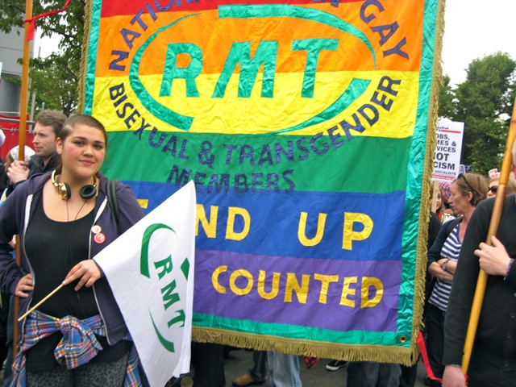

Lesbian,
Gay, Bisexual & Transgender Members’ Conference 2013

Slide 2


welcome to blackpool

Slide 3
general secretary
Bob Crow
- including presentation on the Credit Union

Slide 4
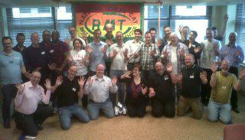
Minutes of the
2012 Conference

Slide 5
Progress report on resolutions carried at the 2012 LGBT Conference
Janine Booth
council of executives

Slide 6
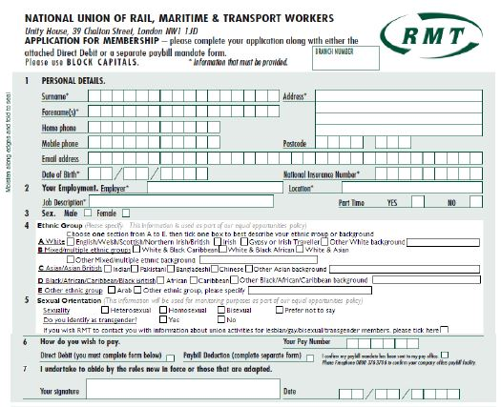
executive report
Sexual orientation monitoring on RMT membership form
Since the introduction of the question earlier this year …
73 new members have answered the question
3 new members have asked for more information on LGBT activities
Figures not yet available for existing members
Article to be included in next-but-one RMT News

Slide 7
executive report
Sexual orientation

Slide 8
executive report
Do you identify as transgender?

Slide 9
executive report
TWO DAYS
RMT LGBT conference is now
TUC LGBT conference
We now aim to
send a full
delegation of
15 delegates

Slide 10
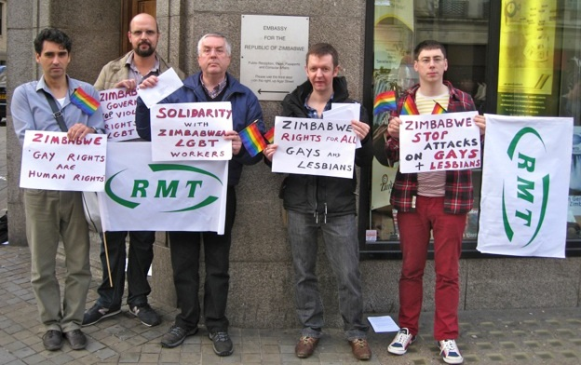
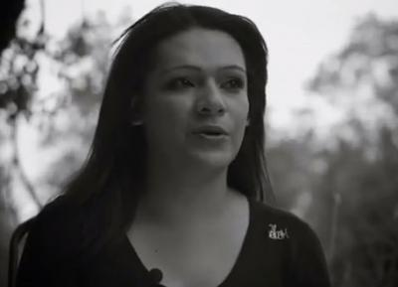
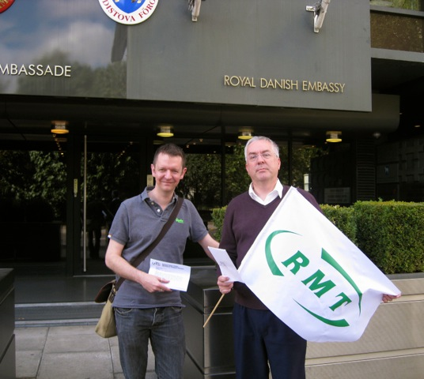
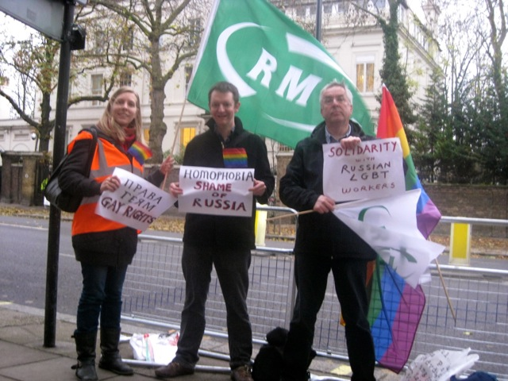
executive report
Resolution:
International LGBT Rights

Slide 11
executive report
Resolution:
RMT National LGBT Advisory Committee
visits to Regional Councils
‘equalities’ item on agenda
strategy against homophobia
new posters – ideas?

Slide 12

executive report
Resolution: Diversity Role Models:
tackling homophobia through education

Slide 13
executive report
Resolution: Aviation industry forced gay flight attendant into a sham marriage
Resolution: Campaign for Equal Marriage

Slide 14
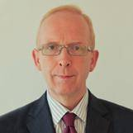


executive report
Resolution: ‘Gay Cure’ adverts on TfL buses
Vernon Everitt
Managing Director of Customer Experience, Marketing & Communications at TfL

Slide 15
executive report
Network Rail – Equality, Diversity and Inclusion
new policy
reps
RMT Training
weekend LGBT course
week-long Equality in the Workplace course
more equalities content in all courses
run courses in your Region

Slide 16
Report from RMT National LGBT Members’ Advisory Committee
Paul Penny
Vice-chair
LGBT Advisory Committee

Slide 17
guest speakers
Kath Talboys, Chief Executive, Renaissance (local sexual health and substance misuse services)
Police Constable Clare Bradley,
Divisional Diversity Officer

Slide 18

guest speaker
Journalist Patrick Strudwick speaks on his ‘gay cure’ investigations

Slide 19
resolutions
Chair asks who is proposing and who is seconding the resolution
The proposer speaks, asking you to support the resolution
The seconder speaks, asking you to support the resolution
The resolution is then ‘open to debate’ – any delegate may speak for, against or about the resolution
Also, any delegate may ask a question
If you wish to speak or ask a question, raise your hand
After everyone who wants to speak has spoken, the proposer will reply to the debate
We then vote on the resolution, by show of hands
You may vote For, Against, or Abstain
If more delegates vote For than Against, the resolution is carried; if more vote Against than For, it falls; if it is a tie, the Chair may cast a deciding vote

Slide 20
resolutions
LGBT Asylum in the UK
submitted by
Central Line East branch

Slide 21

resolutions
Stop
Pinkwashing Employers
submitted by
Central Line East branch

Slide 22
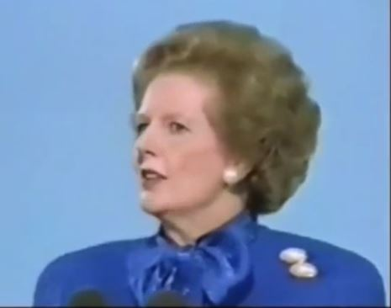
resolutions
Children who need to be taught to respect traditional moral values are being taught that they have an inalienable right to be gay. All of those children are being cheated of a sound start in life—yes, cheated.
Thatcher’s
Legacy of Homophobia
submitted by
Jubilee South branch

Slide 23
resolutions
Support for Gay Men Fighting AIDS
submitted by
Jubilee South branch

Slide 24
resolutions
Homophobic Outburst of Vladimir Yakunin
submitted by Jubilee South branch

Slide 25
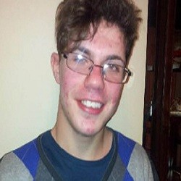
resolutions
Justice for
Steven
Simpson
submitted by Central Line East branch

Slide 26
resolutions
TOCs Promoting LGBT Champions
submitted by
Blackpool and Fylde branch

Slide 27
resolutions
Strategy to Eradicate
Transphobia
submitted by Central Line East branch

Slide 28
resolutions to the agm
The Conference may submit two of the resolutions it has passed to the union’s Annual General Meeting, which takes place in June. If passed by the AGM, they become union policy.
The other resolutions will be submitted to the Council of Executives for their consideration.
The Chair will call out the title of each resolution in turn. You may vote for up to two of them. The two with the most votes will be submitted to the AGM.

Slide 29
resolutions to the agm
LGBT Asylum in the UK
Stop Pinkwashing Employers
Thatcher’s Homophobic Legacy
Support for Gay Men Fighting AIDS
Homophobic Outburst of Vladimir Yakunin
Justice for Steven Simpson
TOCs promoting LGBT champions
Strategy to Eradicate Transphobia

Slide 30
guest speaker
Tawseef Khan
Chair of Imaan Muslim support group
Sexual Orientation and Asylum

Slide 31
guest speaker
Frank Mugisha Executive Director, Sexual Minorities Uganda

Slide 32
conference 2014
Where will next year’s conference take place?
Branches may offer to host the 2014 conference.
If more than one offers,
we will have a vote.

Slide 33
elections
Candidates must be members of the National LGBT Advisory Committee.
Candidates must be nominated and seconded by delegates.
Any delegate may nominate or second any candidate.
If there are more nominations than places available, we will have a vote.

Slide 34
elections
Chair – chairs meetings of the National LGBT Advisory Committee and next year’s conference
Vice Chair – deputises for the Chair if s/he is absent
Liaison Committee members (3) –
to plan next year’s conference

Slide 35
Thank you for
attending
Lesbian, Gay, Bisexual & Transgender Members’ Conference 2013

